Slide 1
Implementation Strategies for complex embedded systems

Slide 2
Lifecycle models:
The fundamentals of design are
Find out what the customers want.
Think of a way to give them what they want.
Prove what you have done by building and testing it.
Build a lot of the product to prove that it wasn‘t an accident.
Use the product to solve the customer‘s problem.

Slide 3
Lifecycle models:
The common life cycle models are:
Waterfall model
V cycle model
Spiral model
Rapid prototype

Slide 4
Waterfall model:
The waterfall model represents a cycle specifically a series of steps appearing much like a waterfall. It is the model which is use to linear process development. It is a sequential design process, often used in software process development in which progress is seen as flowing steadily downwards through the phases of
Conception, Initiation, Analysis, Design, Construction, Testing, Production/Implementation and Maintenance. Figure 4.1 shows the water life cycle model

Slide 5
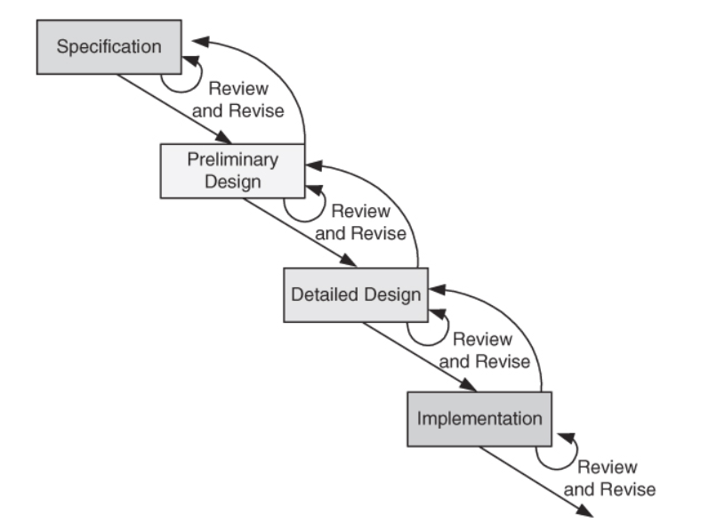
Waterfall model:
The steps are:
Specification.
Preliminary design.
Design review
Detailed design.
Design review.
Implementation.
Review.

Slide 6
Waterfall model:
The waterfall development model originates in the manufacturing and construction industries: highly structured physical environments in which after-the-fact changes are prohibitively costly, if not impossible.
Since no formal software development methodologies existed at the time, this hardware-oriented model was simply adapted for software development.

Slide 7
Waterfall model:
Phases:
1) Requirement : In this phase we gather necessary information which will use for development of any project . This phase defines what to do.
2) Design: In design phase we then construct design to how to implement that requirements gathered into phase 1 .This phase define how to do

Slide 8
Waterfall model:
3) Coding: Now base on design phase we then write actual code to implement algorithms. This code should be efficient.
4) Testing : This phase use to test our coding part it checks all the validation like our code should work for each and every possibilities of input if any bug occur then we have to report that bug to design phase or development phase.
5) Maintenance: In this phase we need keep updating information.

Slide 9
Waterfall model:
Process:
1) The implementation process contains software preparation and transition activities, such as the conception and creation of the maintenance plan;
2) The problem and modification analysis process, which is executed once the application has become the responsibility of the maintenance group.

Slide 10
Waterfall model:
The maintenance programmer must analyze each request, confirm it (by reproducing the situation) and check its validity, investigate it and propose a solution,
Document the request and the solution proposal, and, finally, obtain all the required authorizations to apply the modifications.
3. The process considering the implementation of the modification itself.

Slide 11
Waterfall model:
4) The process acceptance of the modification, by confirming the modified work with the individual who submitted the request in order to make sure the modification provided a solution.
5) The migration process is exceptional, and is not part of daily maintenance tasks. If the software must be ported to another platform without any change in functionality, this process will be used and a maintenance project team is likely to be assigned to this task.

Slide 12
Waterfall model:
6. Finally, the last maintenance process, also an event which does not occur on a daily basis, is the retirement of a piece of software.

Slide 13
V model:
The V-Model is a term applied to a range of models, from a conceptual model designed to produce a simplified understanding of the complexity associated with systems development to detailed, rigorous development lifecycle models and project management models.
Each test phase is identified with its matching development phase as shown in figure 4.2.

Slide 14
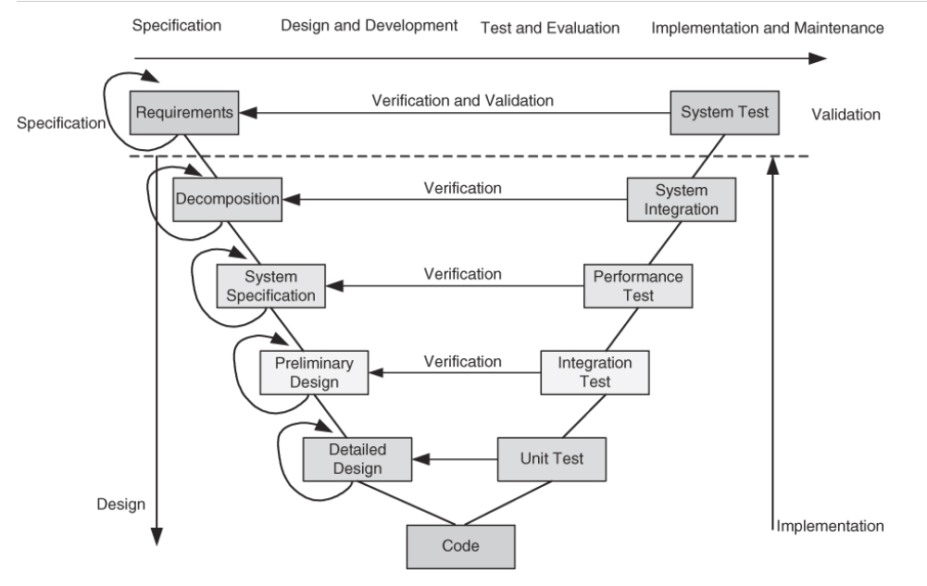
V model:

Slide 15
V model:
The V-model is a graphical representation of the systems development lifecycle. It summarizes the main steps to be taken in conjunction with the corresponding deliverables within computerized system validation framework.
The V represents the sequence of steps in a project life cycle development. It describes the activities to be performed and the results that have to be produced during product development.

Slide 16
V model:
The left side of the "V" represents the decomposition of requirements, and creation of system specifications. The right side of the V represents integration of parts and their validation.
Validation. The assurance that a product, service, or system meets the needs of the customer and other identified stakeholders. It often involves acceptance and suitability with external customers.

Slide 17
V model:
Verification. The evaluation of whether or not a product, service, or system complies with a regulation, requirement, specification, or imposed condition. It is often an internal process.

Slide 18
The spiral model
The spiral model is a software development process combining elements of both design and prototyping-in-stages, in an effort to combine advantages of top-down and bottom-up concepts.
Also known as the spiral lifecycle model (or spiral development), it is a systems development method (SDM) used in information technology (IT).

Slide 19
The spiral model
This model of development combines the features of the prototyping and the waterfall model. The spiral model is intended for large, expensive and complicated projects. A simplified version of that model is presented in figure 4.3.

Slide 20
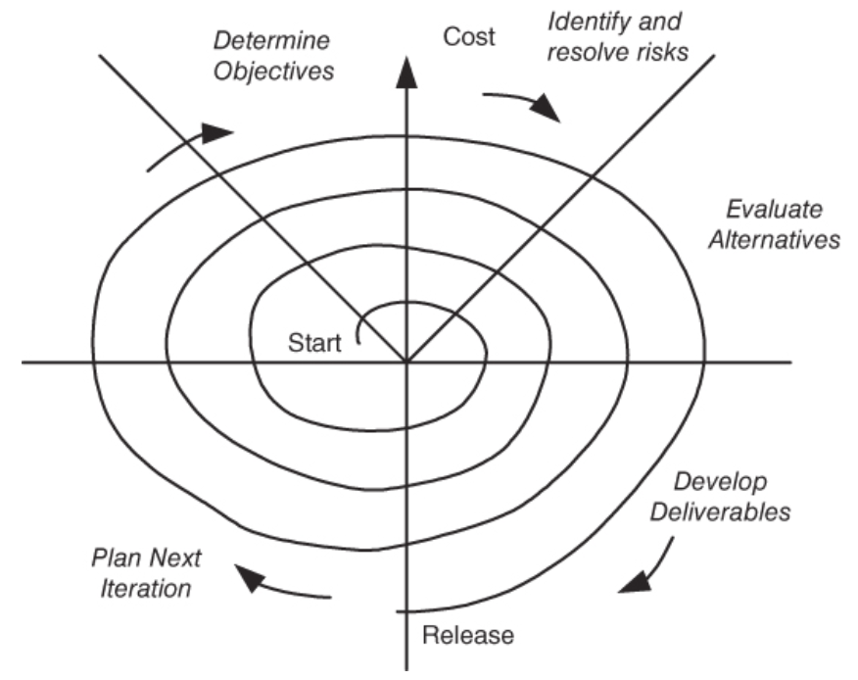
The spiral model
The steps in spiral model life cycle are
Determine objective, alternatives, and constraints.
Identify and resolve risks.
Evaluate alternatives.
Develop deliverables verify that they are correct.
Plan the next iteration.
Commit to an approach for the next iteration.

Slide 21
The spiral model
The spiral model combines the idea of iterative development (prototyping) with the systematic, controlled aspects of the waterfall model. It allows for incremental releases of the product, or incremental refinement through each time around the spiral.
The spiral model also explicitly includes risk management within software development. Identifying major risks, both technical and managerial, and determining how to lessen the risk helps keep the software development process under control.

Slide 22
The spiral model
The spiral model is based on continuous refinement of key products for requirements definition and analysis, system and software design, and implementation. At each iteration around the cycle, the products are extensions of an earlier product.
This model uses many of the same phases as the waterfall model, in essentially the same order, separated by planning, risk assessment, and the building of prototypes and simulations

Slide 23
Rapid prototype
The Rapid prototyping model is intended to provide a rapid implementation of high-level portions of both the software and the hardware. The approach allows developers to construct working portion of hardware and software in incremental stages.
Each stage through the cycle, one incorporates a little more of the intended functionality. The prototype is useful for both the designer and the customer. The prototype can be either evolutionary or throughway. It has the advantage of having a working system early in development process.

Slide 24
Problem solving
The 5 steps to a successful design are
Requirement definition
System specification
Functional design
Architectural design
Prototyping

Slide 25
Problem solving
The design process comprises of five distinct stages although it may vary for particular projects or design disciplines. This information may be useful when working with a designer to understand the processes involved.
Before the project is started however, a vital question has to be asked: ―Why do you need a new identity, brochure or website etc?

Slide 26
Problem solving
Identifying and formulating the requirement specification
Requirements analysis in systems engineering and software engineering, encompasses those tasks that go into determining the needs or conditions to meet for a new or altered product, taking account of the possibly conflicting requirements of the various stakeholders, analyzing, documenting, validating and managing software or system requirements.

Slide 27
Problem solving
Requirements analysis is critical to the success of a systems or software project. The requirements should be documented, actionable, measurable, testable, traceable, related to identified business needs or opportunities, and defined to a level of detail sufficient for system design.
Conceptually, requirements analysis includes three types of activities

Slide 28
Problem solving
Eliciting requirements: the task of identifying the various types of requirements from various sources including project documentation, business process documentation, and stakeholder interviews. This is sometimes also called requirements gathering.
Analyzing requirements: determining whether the stated requirements are clear, complete, consistent and unambiguous, and resolving any apparent conflicts.

Slide 29
Problem solving
Recording requirements: Requirements may be documented in various forms, usually including a summary list and may include natural-language documents, use cases, user stories, or process specifications.

Slide 30
Characterizing the system
Requirements analysis can be a long and arduous process during which many delicate psychological skills are involved. New systems change the environment and relationships between people, so it is important to identify all the stakeholders, take into account all their needs and ensure they understand the implications of the new systems.
Analysts can employ several techniques to elicit the requirements from the customer.

Slide 31
Characterizing the system
Prototyping may be used to develop an example system that can be demonstrated to stakeholders. Where necessary, the analyst will employ a combination of these methods to establish the exact requirements of the stakeholders, so that a system that meets the business needs is produced.

Slide 32
Characterizing the system
The System Design Specification (SDS) is a complete document that contains all of the information needed to develop the system. Systems design is the process of defining the architecture, components, modules, interfaces, and data for a system to satisfy specified requirements.
Systems design could be seen as the application of systems theory to product development. There is some overlap with the disciplines of systems analysis, systems architecture and systems engineering.

Slide 33
Characterizing the system
The requirement specifications provides a view from the outside of the system, design specification provides a view from the inside looking out as well. Design specification has 2 masters:
It must specify the system‘s public interface from inside the system.
It must specify how the requirements defined for and by the public interface are to be met by the initial functions of the system.

Slide 34
Characterizing the system
Six areas should be considered are:
Geographical constraints
Characterization of and constraints on interface signals
User interface requirements
Temporal constraints
Electrical infrastructure consideration
Safety and reliability

Slide 35
Characterizing the system
System specification versus system requirements
Requirements give a description of something wanted or needed. They are a set of needed properties.
Specification is a description of some entity that has or implements those properties.

Slide 36
Characterizing the system
There is a distinct difference between requirements and specifications. A requirement is a condition needed by a user to solve a problem or achieve an objective.
A specification is a document that specifies, in a complete, precise, verifiable manner, the requirements, design, behavior, or other characteristics of a system, and often, the procedures for determining whether these provisions have been satisfied.

Slide 37
Characterizing the system
For example, a requirement for a car could be that the maximum speed to be at least 120mph. The specification for this requirement would include technical information about specific design aspects.
Another term that is commonly seen in books and papers is requirements specification which is a document that specifies the requirements for a system or component. It includes functional requirements, performance requirements, interface requirements, design requirements, and development standards.

Slide 38
Characterizing the system
A specification is a precise description of the system that meets stated requirements. A specification document should be:
Complete
Consistent
Comprehensible
Traceable to the requirement
Unambiguous
Modifiable
Able to be written

Slide 39
Characterizing the system
Functional design
The functional design process maps the "what to do" of the Requirements Specification into the "how to do it" of the design specifications. During this stage, the overall structure of the product is defined from a functional viewpoint.
The functional design describes the logical system flow, data organization, system inputs and outputs, processing rules, and operational characteristics of the product from the user's point of view.

Slide 40
Characterizing the system
Functional Design is a paradigm used to simplify the design of hardware and software devices such as computer software and increasingly, 3D models.
A functional design assures that each modular part of a device has only one responsibility and performs that responsibility with the minimum of side effects on other parts. Functionally designed modules tend to have low coupling.

Slide 41
Characterizing the system
Architectural design
The major objective of the Architectural design activity is the allocation or mapping of the different pieces of system functionality to the appropriate hardware and software blocks. Work is based on the detailed functional structure. The important constraints that must be considered include items as

Slide 42
Characterizing the system
The geographical distribution.
Physical and user interfaces
System performance specifications.
Timing constraints and dependability requirements
Power consumption
Legacy components and cost.

Slide 43
Characterizing the system
Hardware and software specification and design
For the software design, the following must be analyzed and decided:
Whether to use a real time kernel.
Whether several functions can be combined in order to reduce the number of software tasks and if so, how?
A priority for each task.
An implementation technique for each inter-task relationship.

Slide 44
Characterizing the system
The important criteria that we strive to optimize are:
Implementation cost
Development time and cost
Performance and dependability constraints
Power consumption
Size

Slide 45
Characterizing the system
Functional model versus architectural model
The functional model describes a system through a set of interacting functional elements. The design proceeds at a high level without initial bias toward any specific implementation.
The functional models will interact using one of the following 3 types of relations:

Slide 46
Characterizing the system
The shared variable relation: which defines a data exchange without temporal dependencies.
The synchronization relation: which specifies temporal dependency.
The message transfer by port: which implies a producer/consumer kind of relationship.

Slide 47
Characterizing the system
Architectural model
The architectural model describes the physical architecture of the system based on real components such as microprocessor, arrayed logics, special purpose processors, analog and digital components, and the many interconnections between them.

Slide 48
Characterizing the system
Prototyping
The prototype phase leads to an operational system prototype. A prototype implementation includes
Detailed design
Debugging
Validation
Testing

Slide 49
Characterizing the system
A prototype is an early sample or model built to test a concept or process or to act as a thing to be replicated or learned from. It is a term used in a variety of contexts, including semantics, design, electronics, and software programming.
A prototype is designed to test and trial a new design to enhance precision by system analysts and users. Prototyping serves to provide specifications for a real, working system rather than a theoretical one.

